Slide 1

Point Of Sale Billing Invoice
# Dairy Products - Advanced Microsoft Excel Project

Slide 2

3 Sections
POS Billing Layout
Daily Stocks Calculations
Download Billing Invoice

Slide 3

Point Of Sale Billing !?
Smart Billing method for managing sales transactions and calculating invoice based on Customer goods or services.

Slide 4
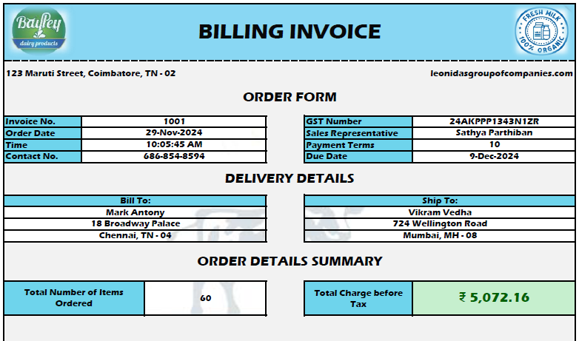
POS Billing Layout
Invoice No
Order Date & Time
Contact No
GST No
Due Date
Customer Name
Address
Shipping Address
Order Details
Total No of Items Order
Total Charge Before Tax
Order Form
Delivery Details

Slide 5
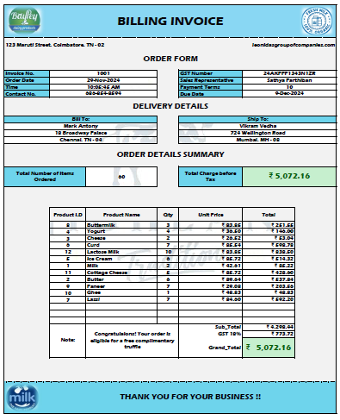
Order Details Summary
Product Id
References Product ID with Product Name from Daily Stocks sheet match data will be resulted.
Product Name
Same as Prod ID, references from Daily Stocks Sheet match data reflected.
Quantity
Preferred by User.
Unit Price
Constant it can’t be modified
Total Amount
Calculation based on Quantity * Unit Price.
GST Calculation
Upon Sub Total, GST Rate is calculated (Subtotal * 0.18) – 18% GST Tax Rate.
Grand Total
Subtotal + GST 18% : Resulted value Grand Total.

Slide 6
Daily Stocks – Prod & Quan Details (Litres)
A | B | C | D | E
Product ID | Product Name | Price per Unit | *Quantity (liters) | Quantity Sold (liters)
1 | Milk | ₹ 18.51 | 400 | 300
2 | Butter | ₹ 70.00 | 200 | 194
3 | Cheese | ₹ 110.00 | 100 | 95
4 | Yogurt | ₹ 36.50 | 200 | 196
5 | Ice Cream | ₹ 90.00 | 200 | 194

Slide 7
Calculation & Formula Section
Match Prod Name
=IFERROR(MATCH(C19,Table1[Product Name],0), " ")
Lookup Unit Price
=XLOOKUP(B19,Table1[Product ID],Table1[Price per Unit]," ")
Calc Total & GST
=SUM(F19:F33) & =F34*0.18
Quan reduced upon Quan Sold
Balance Stocks
= [@[*Quantity (liters)]] - IFERROR(SUMIFS(POS Billing Page!$D$19:$D$33, POS Billing Page!$B$19:$B$33, [@[Product ID]]), 0)
=[@[*Quantity in Stock (litres)]]-Table1[@[Quantity Sold (litres)]]

